Slide 1

Publish your work in Open Access!!
Presentation at the Open Access Roadshow
Schleswig-Holstein 14.11.19
Flensburg
Lars Bjørnshauge
lars@doaj.org
Twitter: @elbjoern0603

Slide 2

Agenda
Why publish in Open Access?
How can I identify good Open Access Journals?
About questionable journals
How DOAJ helps journals make your work visible and get impact

Slide 3
Why publish in Open Access?
Because others tell you to do so!
Research Funders, Universities, Research Centers, Governments etc. have declared that they would like to see the research they fund to be available in Open Access

Slide 4
It all started with the Budapest Open Access Initiative (2002)
Declarations:
  Berlin Declaration on Open Access to Knowledge in the Sciences and Humanities (2003)
  Betheseda Statement on Open Access Publishing (2003)
  and many more
  in general:
    soft recommendations
    allowing embargoes

Slide 5
Over the years many organizations and research funders have pushed for Open Access
  EU – framework programmes – FP7 – Horizon 2020 etc.
  Science Europe
  Various National Research Councils (incl. DFG)
  OA2020
  cOAlition S

Slide 6
Impatience
Increasingly some of the important stakeholders issue stronger Open Access mandates – and they give preference to real OA!
They want to see real OA happen now
Stronger requirements – no embargos – no writing away copyright to the publishers, extensive reuse rights etc.

Slide 7

Universities, Research Funders & Governments:
  increasingly demand real OA – from day one, with extensive re-use rights
  OA to publications seen as part of the Open Science/Open Scholarship agenda
  Are questioning current research assessment practices (Impact Factor etc) and intends to develop new models

Slide 8
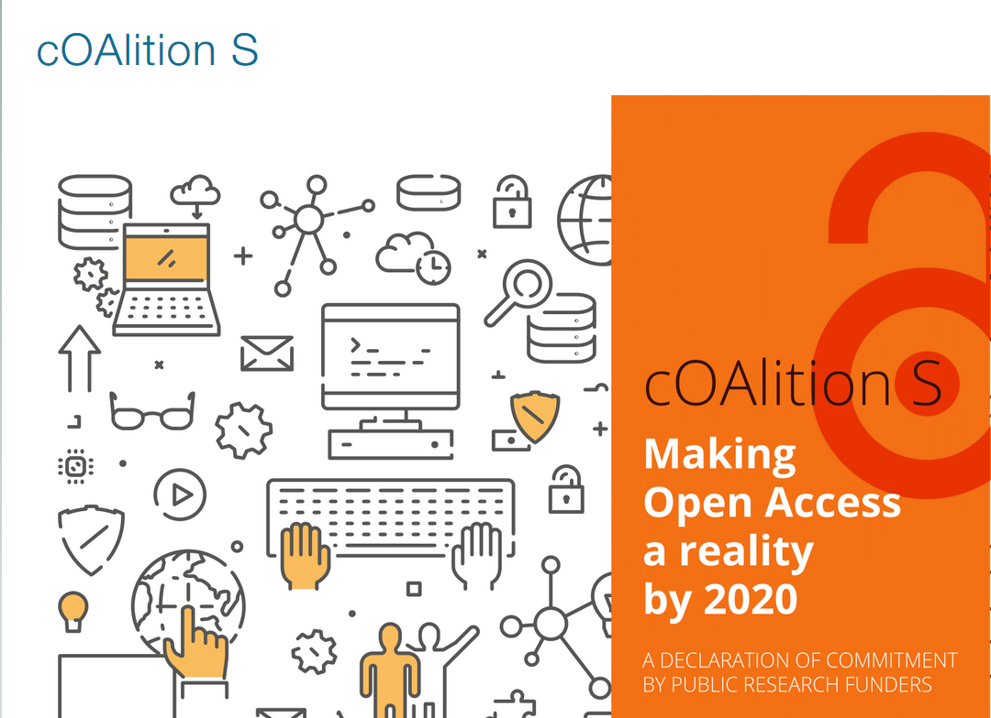
cOAlition S!
https://www.scienceeurope.org/coalition-s/

Slide 9
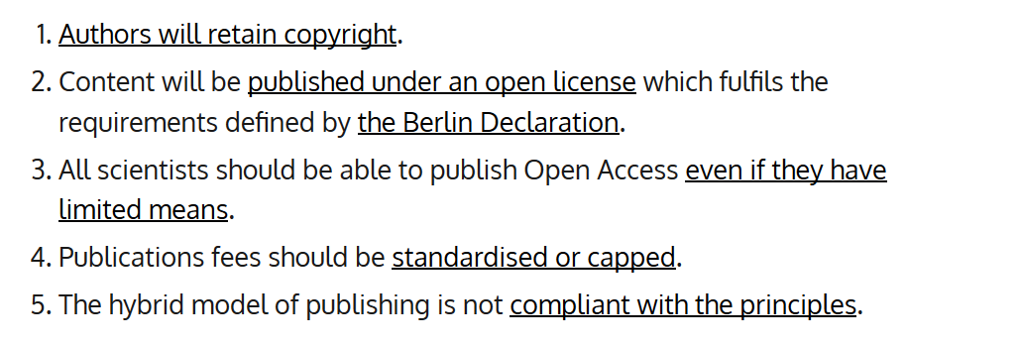

Slide 10
So, there is a stronger push that researchers should publish their works in Open Access, because
it will benefit research, higher education, industri, innovation, our societies and the people.
So far though, not much monitoring for compliance, no real sanctions for researchers that do not comply.

Slide 11
Why publish in Open Access?
Because others tell you to do so!
Because it gives you more visibility and impact!!

Slide 12
If you share your work in the open it
  Gives you more visibility and more impact
  Research results published in Open Access get cited more and earlier compared to papers behind a paywall
  Papers available in Open Access gets more visibility in local, regional, and international media
  You get better connected to colleagues

Slide 13
Why publish in Open Access?
Because others tell you to do so!
Because it gives you more visibility and impact!!
Because you have a moral duty to do so!!
Lots of reasons why you do not publish in Open Access
  It does not benefit your career
  You are not rewarded for publishing in Open Access
  You say you cannot find a relevant publishing channel (a good Open Access journal)
  You cannot/will not pay to be published

Slide 14
We have been discussing Open Access for nearly two decades
Significant progress have been made, but…
It goes too slow!!
It is a widespread notion, that the publishers are to blame!

Slide 15
But…
We should stop blaming the publishers
They do what there are supposed to do:
  Exploiting the conditions offered to them and (some of them) make extraordinary good business.
Those who have the power to change the conditions are responsible for the current mess! … and we have to help them change the system to provide you with incentives to share your work!

Slide 16
Obstacles to Open Access
Research Assessment and Reward systems
”Academic Freedom”
Culture in the Academy

Slide 17
Research Assessment
The single most important obstacle to a transition to Open Access!
Assessment is often based on the Journal Impact Factor (JIF) and other journal level metrics are
  not telling much about the quality of the actual research
  subject to manipulation, gaming and fraud
Researchers are NOT primarily rewarded for WHAT they publish, but WHERE they publish
Research assessment systems have to change
And they are (slowly) changing – away from focussing on ”prestige” journals and the use of the Journal Impact Factor as a proxy for quality!
Notes:
Terrible consequences – globally, starving out smaller and innovate publishers

Slide 18
What pays off in the current system??
As a Researcher:
Publish in quality prestige journals – go for the High Impact Factor journals and you will be rewarded (promotion, tenure and grants)
Don´t bother to much about whether or not
    your results are actually accessible for the widest possible audience
    your data are archived and open
    your software is documented and available
    your research is actually reproducable
For your career it doesn´t (so far) really matter that much!
As an Institution:
  Attract the researchers with the above behavior and the institution will get higher rankings and receive more grants

Slide 19
  The Culture of the Academy
  The Culture of the Academy needs to change!
  The concept of Academic Freedom is often used as an excuse for publishing in the “prestige” journals.
  It is the underlying logic of the invention of Green Access and Hybrid Open Access.
  But Academic Freedom applies to what you are researching, what you are investigating, the methods you apply etc.
  Based on your agreement with your institution and the grants you get, you will do your research.

Slide 20
  Academic Freedom
  It is often argued that your decisions as to where you publish, how you publish, the rights and permissions you give to readers/users etc belongs to your Academic Freedom.
  “It is my Academic Freedom to decide where to publish”!
Notes:
The origins of Green can be seen as a give in to the Academic Freedom. With Green OA, authors can continue to publish in their favourite, prestige journals. But as mentioned there are significant issues with Green OA – basically it does not deliver Real OA, but mostly delayed OA.

Slide 21
  Academic Freedom
  It is often argued that your decisions as to where you publish, how you publish, the rights and permissions you give to readers/users etc belongs to your Academic Freedom.
  “It is my Academic Freedom to decide where to publish”!
  I disagree!
  Let me introduce a different concept:
  Academic Responsibility and responsible researcher behavior!
Notes:
The origins of Green can be seen as a give in to the Academic Freedom. With Green OA, authors can continue to publish in their favourite, prestige journals. But as mentioned there are significant issues with Green OA – basically it does not deliver Real OA, but mostly delayed OA.

Slide 22
Academic Responsibility
Applies to how you share your research, your findings, your data, your software!!
We need stronger mandates from research funders and research institutions
Research funders and research institutions should be very specific as to how they expect researchers to disseminate their findings!
Responsible researcher conduct is to share results, data and software in the open and researchers should be rewarded for that!
Notes:
When university managers, research funders and government state ask for a specific behaviour, namely that papers should be published in OA, then those who do that should be rewarded, and those who do not should be sanctioned.

Slide 23
It should have been open in the first place!
If your papers, your data and your software are not in the open, it should not count!

Slide 24
Who can change the system then?
Not the Publishers – they are businesses, exploiting the conditions offered to them.
The research funders, university managements, governments can change the system
  Change the reward and incentive systems
  Require publishing in the open
  Setting the conditions for the publishers
  Changing the culture in the academy

Slide 25
What is needed is …
More and much stronger funder and institutional mandates
Radical changes in the research evaluation system and incentives for researchers to publish in the open!
  Today researchers are rewarded based on Where they publish, i.e. in which journals they publish
  Not based on What they publish, the actual content
  and not based on How they publish, whether it is open and reuseable or not
And a cultural change in academia is needed!

Slide 26
The scholarly system I want to see
Research results are immediately accessible to everyone.
Research is verifiable and reproducable.
Research is evaluated based on its actual impact - not based on the wrapper (the journal title)
Research findings are evaluated in the open after dissemination.

Slide 27
This means That:
Research will be disseminated in the open with generous reuse permissions.
Research Data will be archived and made accessible.
Software associated with research will be documented and available as well.
Research Evaluation is transparent.

Slide 28
And this means that:
Researchers are rewarded
  not only based on citations, but as well for
  the societal impact of their research,
  documenting their data and software and make it open,
  contributing to peer review etc.
In short:
  Researchers will be rewarded for sharing
  Researchers will be rewarded for all what they do

Slide 29
Agenda
Why publish in Open Access?
How can I identify good Open Access Journals?
About questionable journals
How DOAJ helps journals make your work visible and get impact

Slide 30
DOAJ -It is all about…
Making Open Access journals more attractive as publishing channels!
The mission of DOAJ is to help publishers do a better job in making their journals attractive, transparent publishing channels on a global scale

Slide 31
How do we work?
Journals apply via the application form
The application form is available in 16 languages

Slide 32
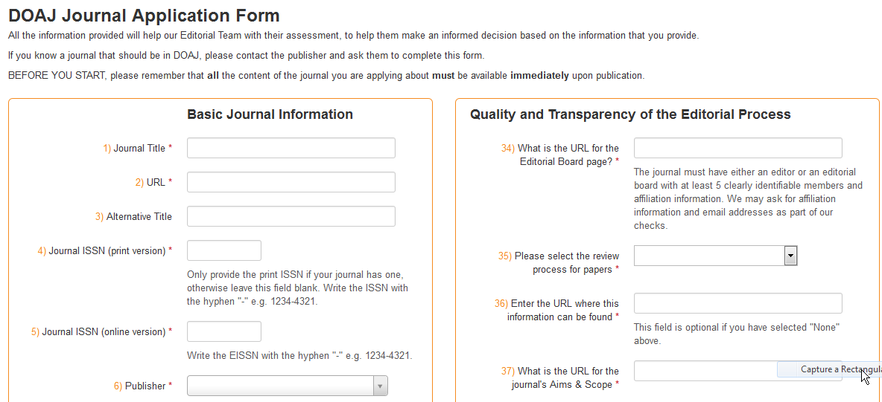
The application form
http://doaj.org/application/new

Slide 33
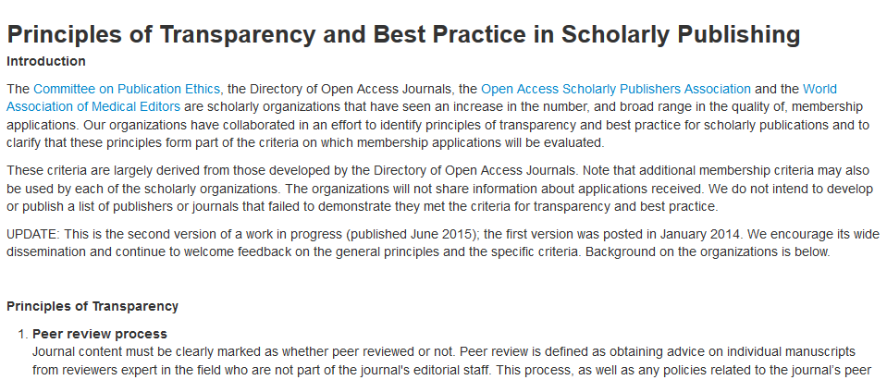
The principles of Transparency and Best Practice in Scholarly Communication
The Principles are very much inspired by the initial draft of the new DOAJ criteria, apply not only for Open Access publishing and has developed into de-facto standards.
https://doaj.org/bestpractice

Slide 34
The Principles
1. Peer review process
2. Governing Body
3. Editorial team/contact
4. Author fees
5. Copyright
6. Identification of and dealing with allegations of research misconduct
7. Ownership and management
8. Web site.
9. Name of journal
10. Conflicts of interest
11. Access
12. Revenue sources
13. Advertising
14. Publishing schedule
15. Archiving
16. Direct marketing

Slide 35
How do we work?
Journals apply via the application form
  So far DOAJ is not actively going out to solicit applications
Lots of information is provided to enable journals to produce a good and detailed application
Applications are initially triaged
We receive around 500+ applications/month

Slide 36
Must haves for journals to be listed:
  An Open Access statement
  Comply with the BOAI definition
  A peer-review process, and a description of the of process
  An editor/editorial board with clearly identifiable members
  Licensing and copyright information
  Aims and scope
  Publish a least 5 articles per year to qualify

Slide 37
Recommendations to journals wanting to be listed
  Unrestricted copyright for the author
  No exclusive publishing rights
  No transfer of commercial rights
  Clear licensing conditions
  Preferably use of Creative Commons licensing
  Embedded licensing information with articles
  No mention of impact factors

Slide 38
Founded at Lund University, Sweden – launched May 2003 with 300 journals - since 2013 operated by Infrastructure Services for Open Access (www.is4oa.org) – a non-profit company registered in the United Kingdom
Basic demand then:
Just a list of Open Access Journals
Gradually developing in to a service recognized by lots of universities, research funders and governments as the authoritative go-to point for peer-reviewed scholarly journals not based on the subscription model

Slide 39
DOAJ – much more than a list of journals!
A global list of peer-reviewed Open Access journals – all subjects and languages
  journals undergo evaluation based on a set of criteria
  13.900 titles (November 2019)
An aggregation of article level metadata
  Publishers upload article metadata into DOAJ
  79% of the journals do so
  Currently 4.400.000 records
Applications rejected: 19,950
Rejection Rate: 55%
All DOAJ services including reviewing applications are free of charge
All DOAJ data are free for all to use, download and re-use

Slide 40
Agenda
Why publish in Open Access?
How can I identify good Open Access Journals?
About questionable journals
How DOAJ helps journals make your work visible and get impact

Slide 41
Questionable or unethical publishers

Slide 42
Questionable publishing is not a phenomenon that is specific to Open Access publishing!

Slide 43
Our definition:
Questionable publishers is publishers, who are not living up to reasonable standards in terms of content, services, transparency and business behavior.
Notes:
Two kinds: many would actually like to do a decent job, but lack the knowledge – many are just exploiting and cheating

Slide 44
The Drivers
Why are researchers publishing in questionable journals?
  Ignorance – lack of attention to the faith of the paper
  Aggressive marketing cheats researchers
  Publish or Perish – get something on my C.V. – subito! – pays off!
  Research Assessment – decision makers counting beans!
Notes:
International j of

Slide 45
Reducing the attraction
Research managers/funders/decision makers:
  Research assessment based on actual assessment of the research!!
  OA-publishing mandates
  Lists of accredited publishing channels!?
Professors/PI/research managers:
  Make Publishing Literacy an integral part of (training in) Research Integrity

Slide 46
How to spot Questionable Publishers/Journals
Notes:
Two kinds: many would actually like to do a decent job, but lack the knowledge – many are just exploiting and cheating

Slide 47
The 5 minute check
Competent web-site?
Mass e-mails asking for editors and submissions?
In the DOAJ? – if not: worrying
Usage statistics?
Stable in the discipline?
Misspelled journal titles?
Journal launch dates – many at the same time?
Empty shells- no/few articles?
Check list from Gavia Library (the library loon) -http://gavialib.com/2012/04/assessing-the-scamminess-of-a-purported-open-access-publisher/– april 2012

Slide 48
The 5 minute check
Regularly publishing?
Many “Edited volumes”?
Quality of writing, copyediting and typesetting?
Archiving arrangement?
Editorial Board – identifiable?
Other financial support – only relying on APCs?
Relevant Advertising?
Running many/expensive conferences?

Slide 49
How we spot them!
How does DOAJ detect questionable journals?
Our approach is based on:
the Principles of Transparency and Best Practice in Scholarly Publishing

Slide 50
How we spot them!
How does DOAJ detect questionable journals?
Low publishing quality
  Journal name, website, fees, peer review, publisher, ownership, volume of articles, advertisements, prominent soliciting for editors, ambiguous company address, many journals and few articles
Low scientific quality
  focus, format, self-citations, plagiarism
Malpractice
  false claims, hidden costs, spamming authors, wrong information,

Slide 51
and more….
Inappropriate marketing practices
  Spam emails
Journal titles with “International”, “American”, “European” or even “Universal”!!
Very broad scope, multidiscplinary
Fake impact factors
Advertise very quick publishing
Advertise a relative low publication fee
No or little quality control of articles
Low-standard peer review process or even don’t have peer review at all

Slide 52
But!!
It is the complete assessment of the journal/publisher that forms the final picture.
A minor set of shortcomings isn't enough ”evidence” to label someone a Questionable Publisher.
Shortcomings often based on lack of knowledge!
We are in it to help honest publishers do a better job!!

Slide 53
More help to researchers to avoid Questionable Publishers
It´s easy: think!!!

Slide 54
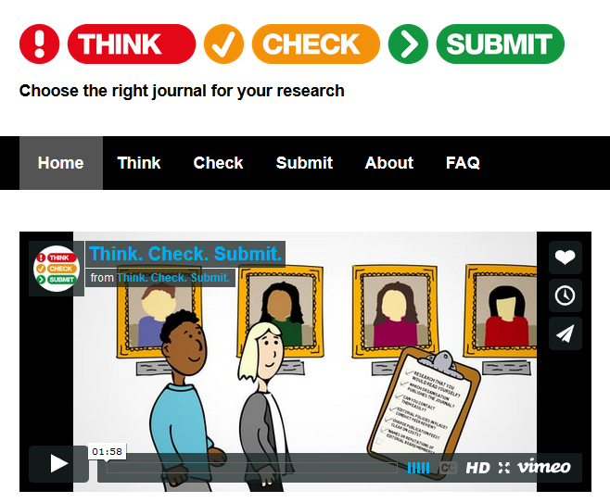


Slide 55
http://thinkchecksubmit.org/ and of course:
Check DOAJ – if the journals is not listed, then:
Watch out!!

Slide 56
Agenda
Why publish in Open Access?
How can I identify good Open Access Journals?
About questionable journals
How DOAJ helps journals make your work visible and get impact

Slide 57
Dissemination!

Slide 58

DOAJ is aggregating article level metadata
Publisher upload
article metadata
3.350.000 article metadata records

Slide 59
Harvesting data
from DOAJ
To
Library Systems,
Discovery Services
etc

Slide 60
DOAJ data (journal data and article level metadata) are
  picked up by all major search engines (Google etc)
  Integrated in all major discovery services and indexes
Which means that the journals listed in DOAJ will appear in those services alongside the more wellknown journals
DOAJ have massive traffic from our harvester and API

Slide 61
Usage/traffic
Unique sessions
3.4 million (2015)
8.3 million (2017)
12.4 million (2019 so far)
DOAJ have massive traffic from our harvester and API
  API traffic: 200.000.000 records/year

Slide 62
The DOAJ core team
Managing Director
Operations Manager
Project and Communications Manager
Editor-in-Chief
Senior Managing Editor
6 Managing Editors
We are based in Sweden, United Kingdom, the Netherlands, Italy, Spain, Mexico, Peru, China, Singapore & Denmark
  And…

Slide 63
Volunteers and Ambassadors
90+ Voluntary Editors/Associate Editors working unpaid a few hours/week – distributed in editorial groups managing 20+ languages
20 Ambassadors recruited to
  Promote DOAJ
  Handle applications of journals to be listed in DOAJ
  Promote best publishing practice and
  Help identifying and spotting questionable and unethical publishers
Ambassadors are based in
  China, India, Russia, Egypt, Burkina Faso, Algeria, South Africa and Mexico, Indonesia & Korea – covering Asia, Middle East, Africa and Latin America

Slide 64
Funding
DOAJ is independent and entirely dependent on funding from the community
  Universities, university libraries and library consortia can supports DOAJ with a yearly membership fee - https://doaj.org/membership
  Smaller publishers can as well support DOAJ via a yearly membership fee – https://doaj.org/support
  Larger publishers can sponsor DOAJ - https://doaj.org/sponsors.

Slide 65
Funding
600 University libraries from 36 countries
17 Library Consortia from 13 Countries
10 Research Funders/Academies of Science
30+ smaller publishers
25+ Sponsors - publishers and aggregators
80% of income from the community
20% of income from publishers

Slide 66
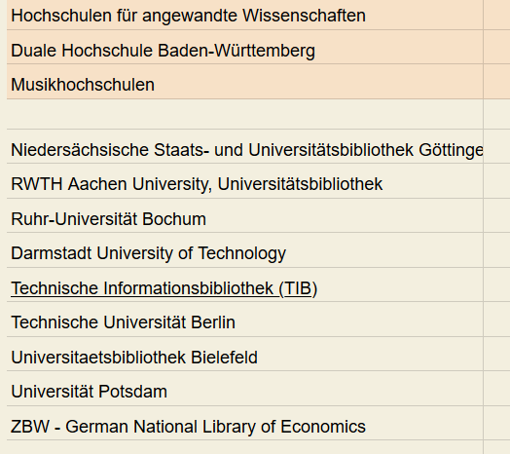
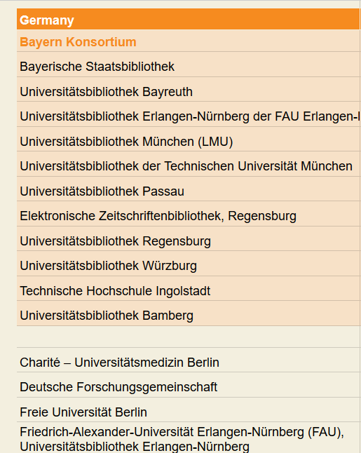
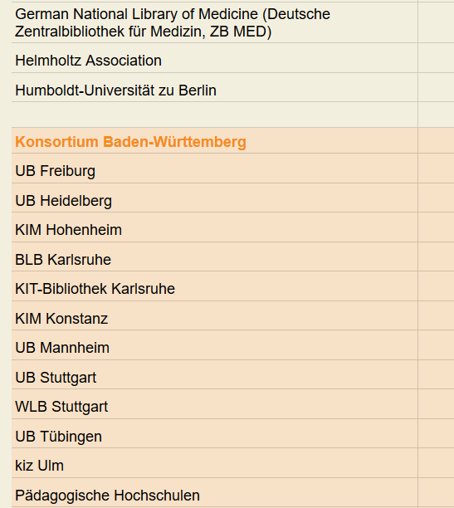

Slide 67
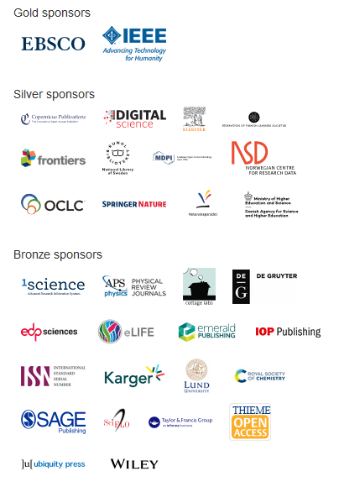
And thank you for listening!
Thanks to :
All the Library Consortia,
Universities,
Research Funders and Publishers
and our Sponsors
for the financial support to DOAJ!

